Slide 1
Energy Load Forecasting

Slide 2
Background:
Energy companies such as SDG&E provide energy to the consumers in the market.
Providing this energy comes with a cost to the company in a couple ways.
Initial cost to provide the energy needed
Possible loss in selling back unused energy
Possible cost increase to buy immediate energy when there is a shortage
To minimize this cost, companies use different forecasting techniques to predict future load and buy future energy for a lower price.

Slide 3
Purpose:
Use machine learning techniques to forecast future SDG&E energy loads based on future weather conditions.
Provide a place for users to input future weather conditions and see the predicted load given those conditions.
Ultimate Goal:
Expand to multiple companies
Use weather API’s to bring in future weather forecast for automated load prediction

Slide 4
Process:
Gather historical SDG&E load data
Gather historical weather conditions for SDG&E market
Clean and join data
Use TimeSeriesSplit to split data into multiple train/test splits
Use RandomForrest on the splits to build model
Saved model to be used for future projections
Build interface for user input of weather conditions

Slide 5
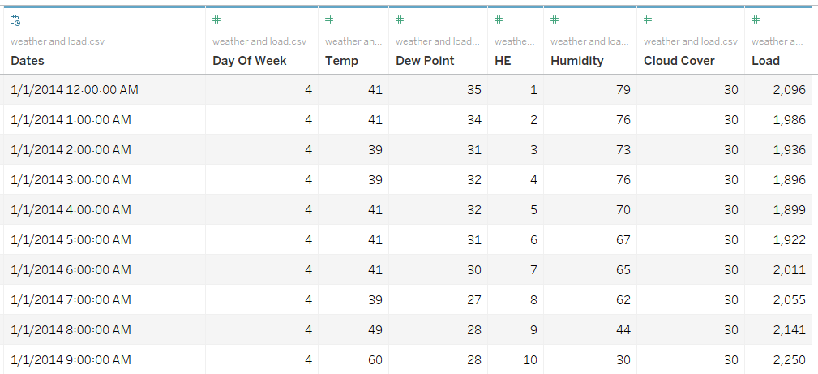
Data:
Dates = Hourly 2014 – 2018
Day of the week
Temp = Degrees F
Dew Point
Humidity
Cloud Cover
Load

Slide 6
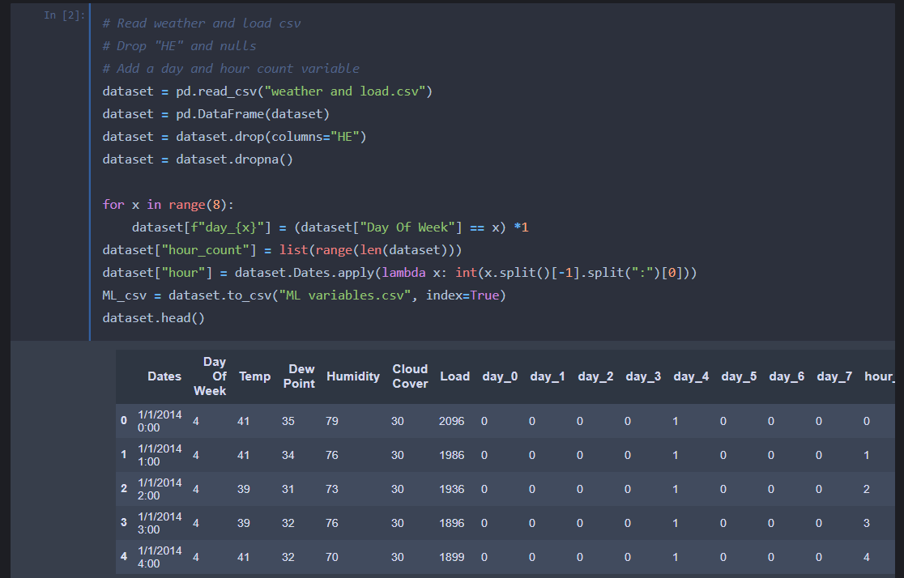
Code:
Here we read in the historical load and weather data and create a data frame that gives each day of the week a Boolean (True = 1, False = 0) value to which day of the week the data represents.

Slide 7
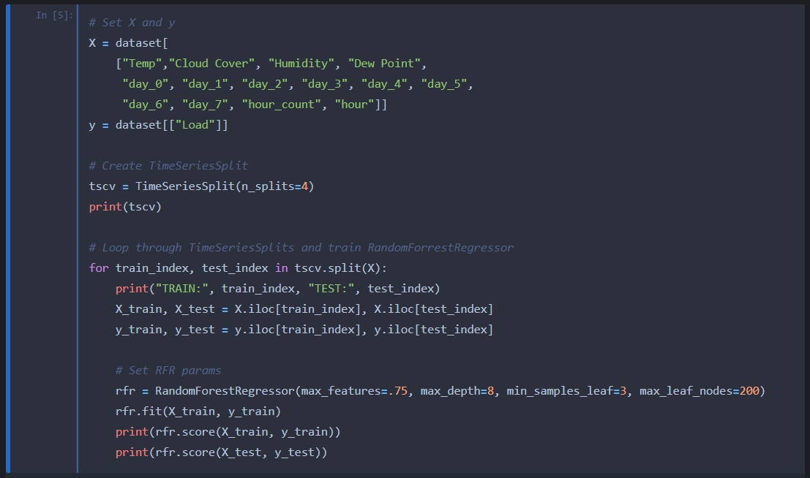
Code:
Once the dataframe is constructed, we then set the X,y sets for the model. Using a TimeSeriesSplit, we can create the train and test splits to be run.
Tuning the RanomForrest is crucial to prevent overfitting and then we can run and print the results.

Slide 8
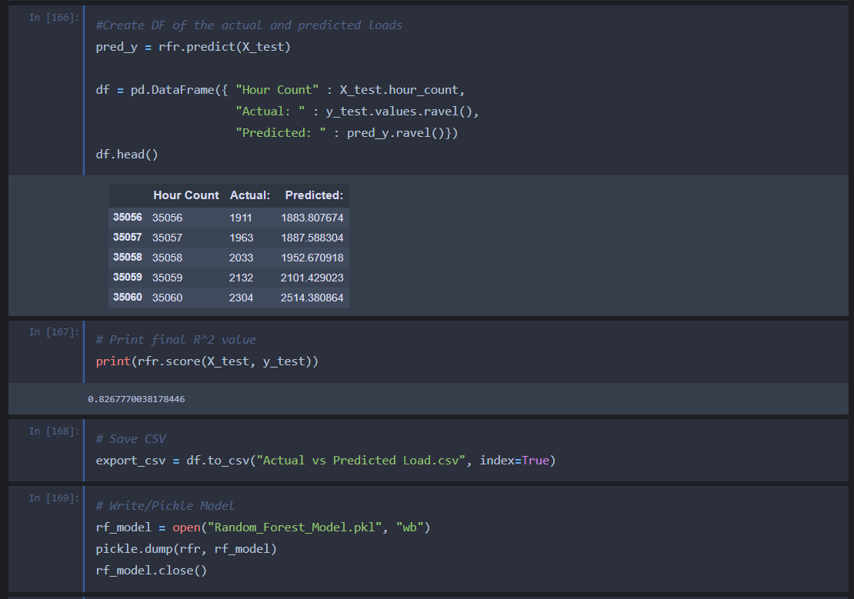
Code:
After running the model, the test results can be put in a dataframe next to the actual test set to compare accuracy.
The score ( r^2) returned 82.68%.
From there the dataframe is exported t .csv to by fed into Tableau for visualization.
The last step is to save the model, so it doesn’t need to be trained every time the application is run.

Slide 9
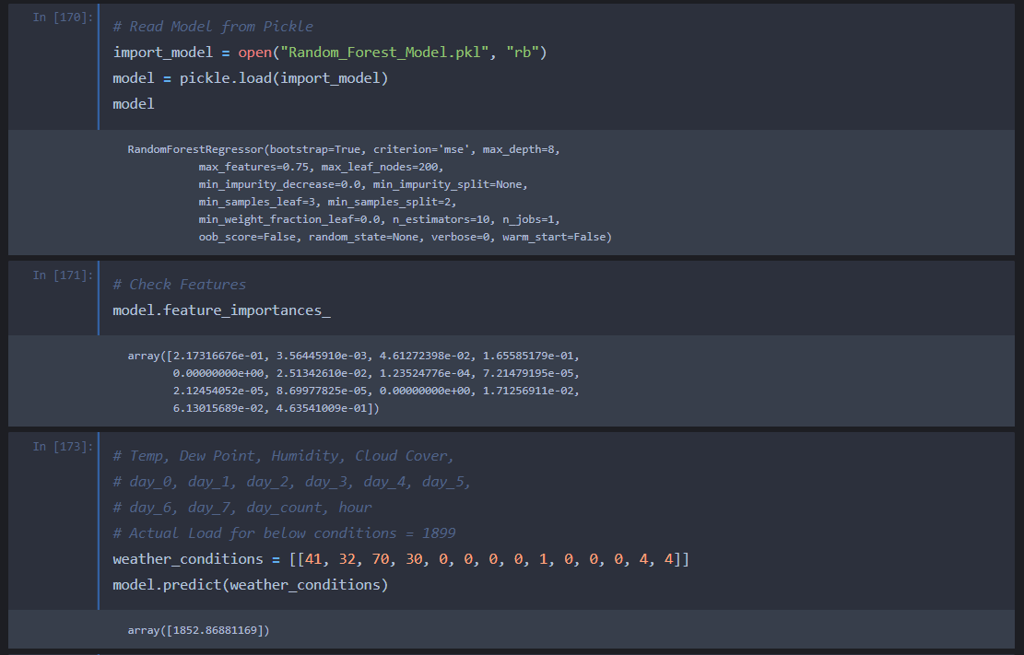
Code:
To make sure the model will function correctly in the app, we open the model, check the features, and manually put in historical data to check the output.
Historical Load: 1899 megawatts
Predicted Load: 1853 megawatts

Slide 10
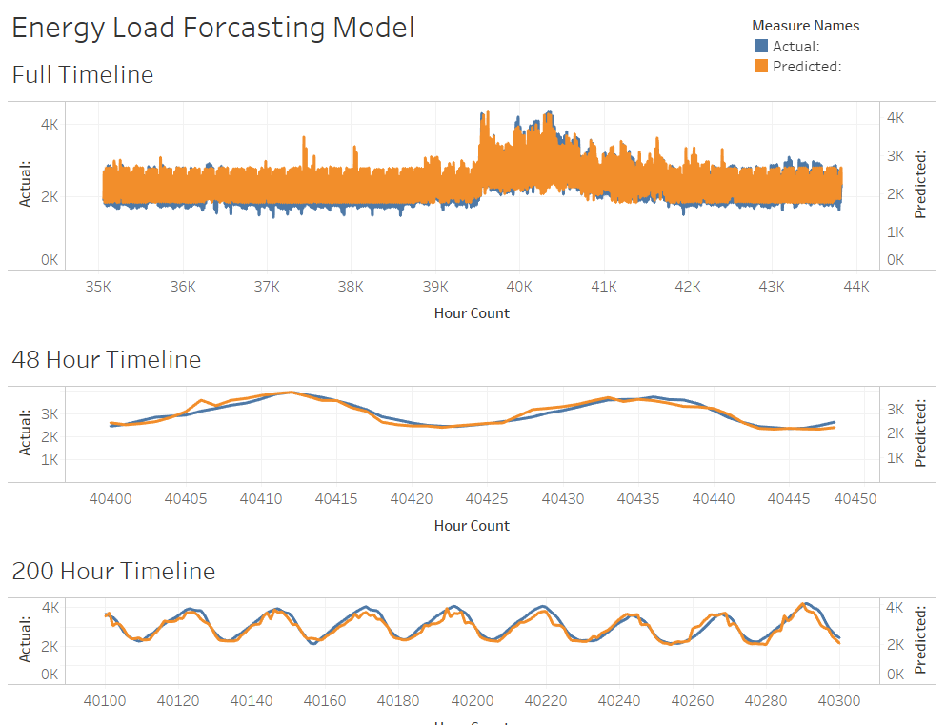
Model Predictions
Taking the results of the test set in the model, we can compare them to the historical data and see how the model performs in a visual way.

Slide 11
Running The Application

Slide 12
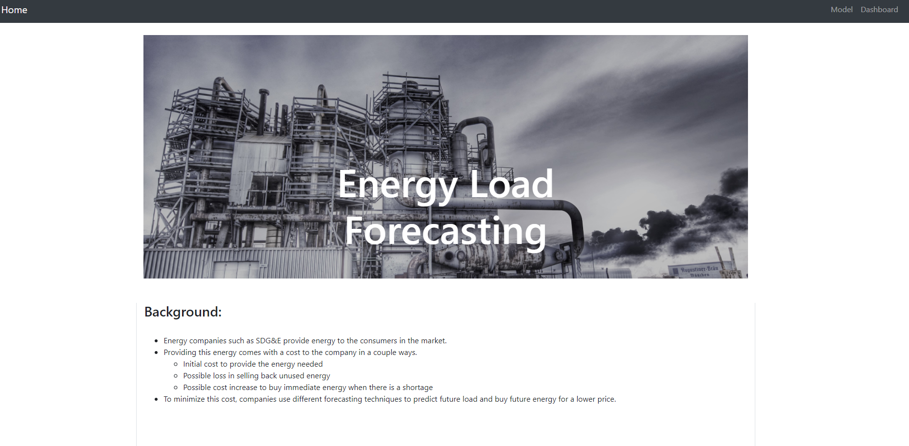
Home Page
The homepage provides a background of what the application aims to accomplish.
From here you can click the “Model” link in the top left to run predictions on projected weather forecasts.
You can also click the “Dashboard” link to be taken to a Tableau dashboard of the data that was collected.

Slide 13
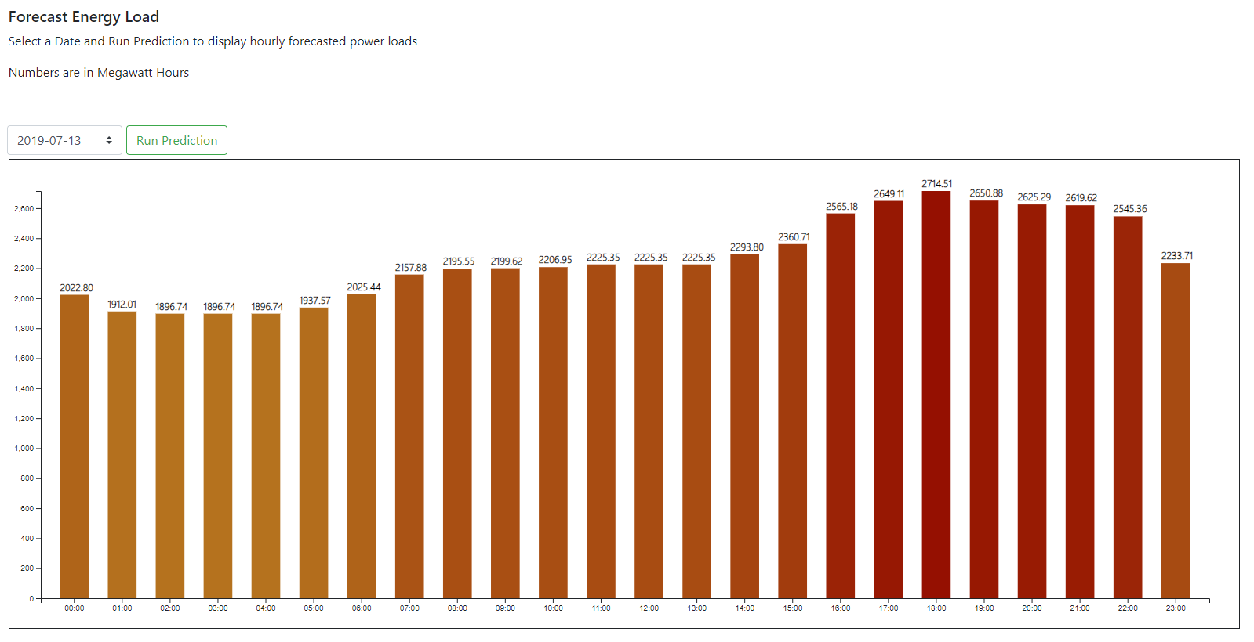
Model Predictions
Using a Random Forrest model on the historical weather and load data we can now run hourly predictions on future weather forecasts.
Here we have the predicted hourly load, in megawatt hours, for July 13, 2019 and using the drop down you can choose other dates through 2019.

Slide 14
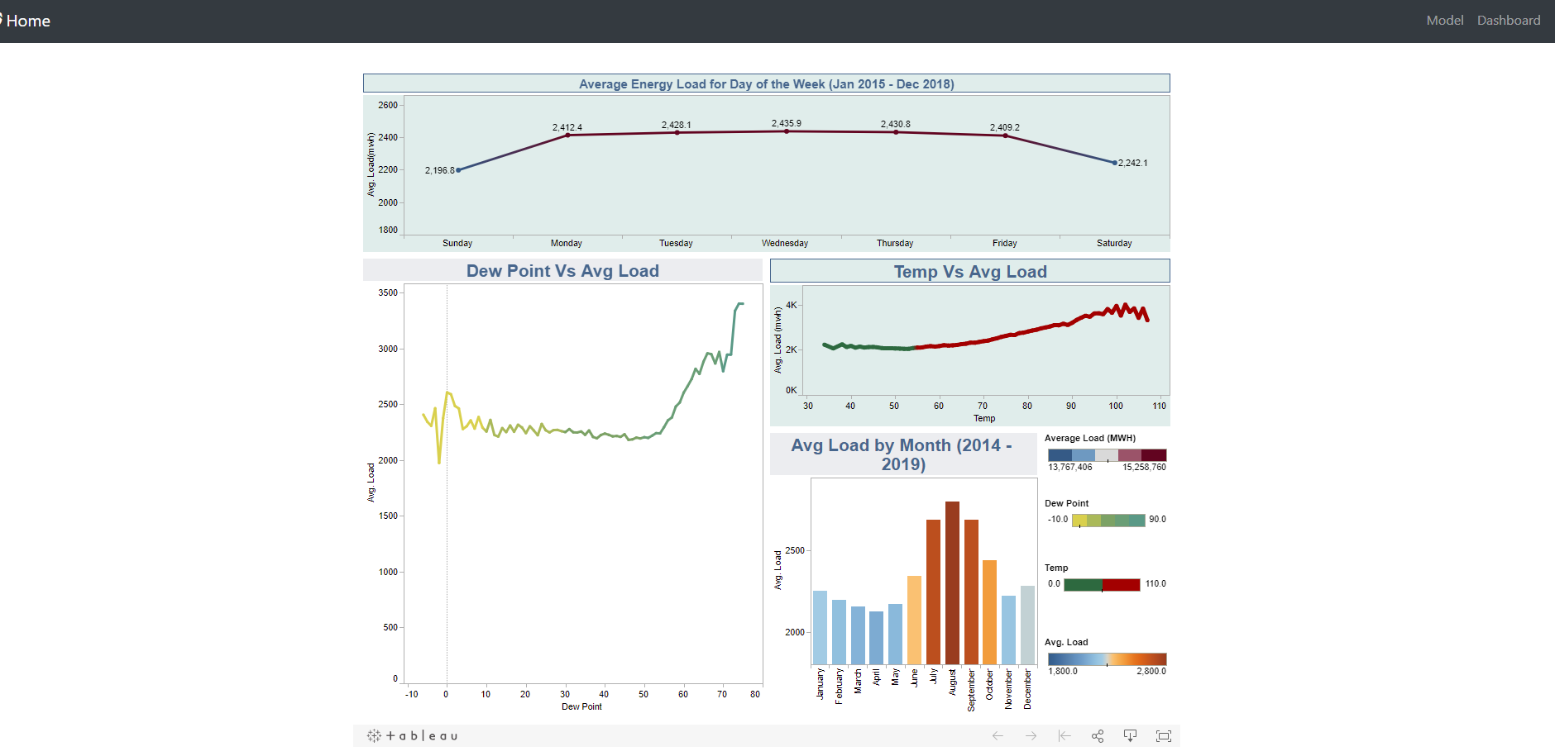
Data Dashboard
Using the different data points in the historical data we can use Tableau to build a dashboard and get more insight to how weather impacts energy loads.
The months with the most energy consumed are the summer months with the hottest temperatures and weekends tend to have the lower average amount of energy consumption.

